Slide 1
How Visual Analytics adds value to PPDM Datastores
Notes:
How Visual Analytics adds value to PPDM Datastores
My name is Yogi Schulz
Thank you to PPDM Association staff for inviting me to speak today
Many E&P companies are trying to determine how to drive value from Visual Analytics and from PPDM datastore to advance their business plan
These discussions are typically occurring in separate silos; today I want to tie these two topics together
My goal is to show How Visual Analytics adds value for PPDM Datastores
I want to increase our understanding of the value of visual analytics
What is the incremental benefit that visual analytics brings to the opportunity to wring more value from our data; especially PPDM-managed data?
This presentation is based on the experience I gathered from a project I led for an oil & gas producer in 2013 and 2014
The project continued in 2014 because we were able to build confidence in the project sponsor in 2013 that we were on the right track. Confidence was achieved by:
Selecting an appropriate Visual Analytics software package
Implementing the software smoothly and on time
Training the end-users, production engineers in our case, thoroughly
Delivering modest, tangible benefits in the first year
Delivering spectacular but irrefutable, tangible benefits in the second year
Staying focused on the business case and not becoming distracted by interesting, adjacent problems and solutions

Slide 2
Yogi Schulz Biography
Partner in Corvelle Consulting
Information technology related management consulting
Microsoft Canada columnist & CBC Radio guest
PPDM Association board member
Industry presenter:
Project World - 6 years
PMI – SAC - 3 years
PMI - Information Systems SIG - 2 years
PPDM Association - several years
Notes:
Title: Yogi Schulz - Biography
Who am I?
I’m a Partner of Corvelle Consulting
We offer information technology related management consulting
We have executed many project management and systems development assignments for our clients
Many of our clients operate in the upstream oil & gas industry
I have written many columns for Computing Canada. These columns have tended to focus on project management and systems development themes. The audience is composed largely of IT executives and managers
For two years, I wrote columns for the Microsoft website. These columns described useful responses to IT developments for a general audience of business managers
For a while I was a CBC Radio guest with an information technology theme
For twenty years I served as a PPDM Association board member
I’ve participated in many industry conferences as a presenter:
Project World - 6 years
PMI SAC – 3 years
PMI - Information Systems SIG – 2 years
Professional Petroleum Data Management Association - PPDM Association - several years

Slide 3
Finding PPDM is like Finding Waldo
Notes:
So let’s talk about the problem: Finding PPDM is often a lot like Finding Waldo
PPDM is so deeply buried in the computing infrastructure at most oil & gas producers that most end-users don’t even know PPDM is there
Very few people outside this room and this small community ever talk about PPDM
As a result, PPDM is invisible just like Waldo
If PPDM is invisible, management and end-users can’t appreciate:
How PPDM is a critical component of the computing infrastructure
The benefits PPDM delivers all day every day
So today we’re going to talk about how visual analytics can make PPDM visible and thereby increase the value of both visual analytics and PPDM for oil & gas producers
I suspect we’ve all run into the problem of the invisible PPDM
Have you identified some effective ways to describe the value of PPDM at your company?

Slide 4
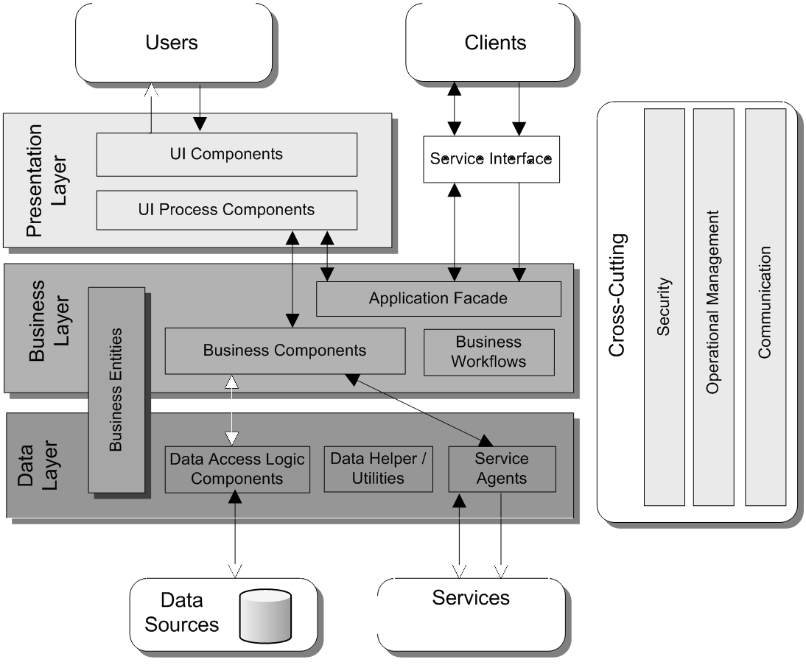
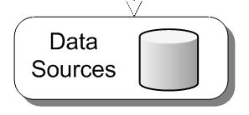
Where is PPDM?
Visual Analytics
Notes:
Where is PPDM?
This is a typical diagram of the application infrastructure layers that are found in the computing infrastructure of all oil & gas producers
Many vendors use a diagram like this to explain where their product fits and how it adds value for their customers
Where’s PPDM?
We’ll use Waldo to help us identify where PPDM sits
Our giant magnifying glass helps us recognize that PPDM is a small subset of this tiny cylinder at the very bottom of the diagram
Because PPDM is so deeply buried in the computing infrastructure at most oil & gas producers, most end-users don’t know it’s there
It’s easy to be blissfully unaware, forget or ignore the value PPDM adds
However, PPDM is just as important as the technologies located in the other boxes on this diagram
Visual analytics software spans these 3 layers of the application infrastructure
In my view. using Visual analytics software has become the way to make PPDM data visible so it can be valued

Slide 5
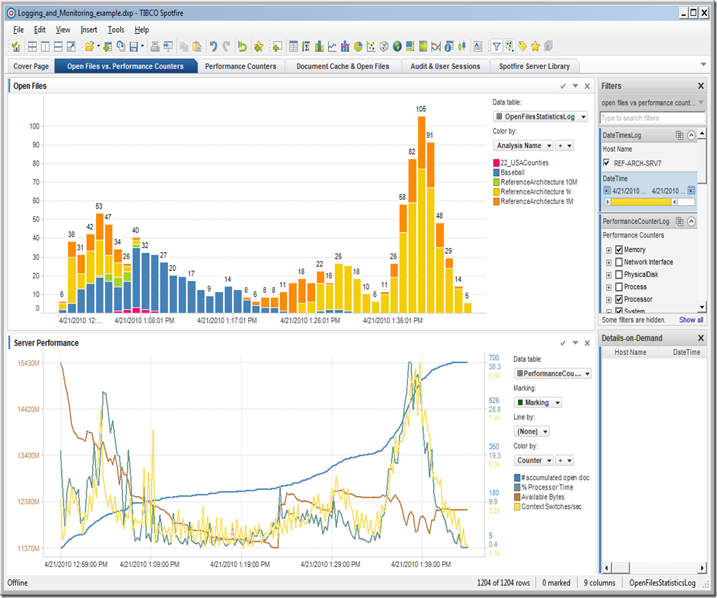
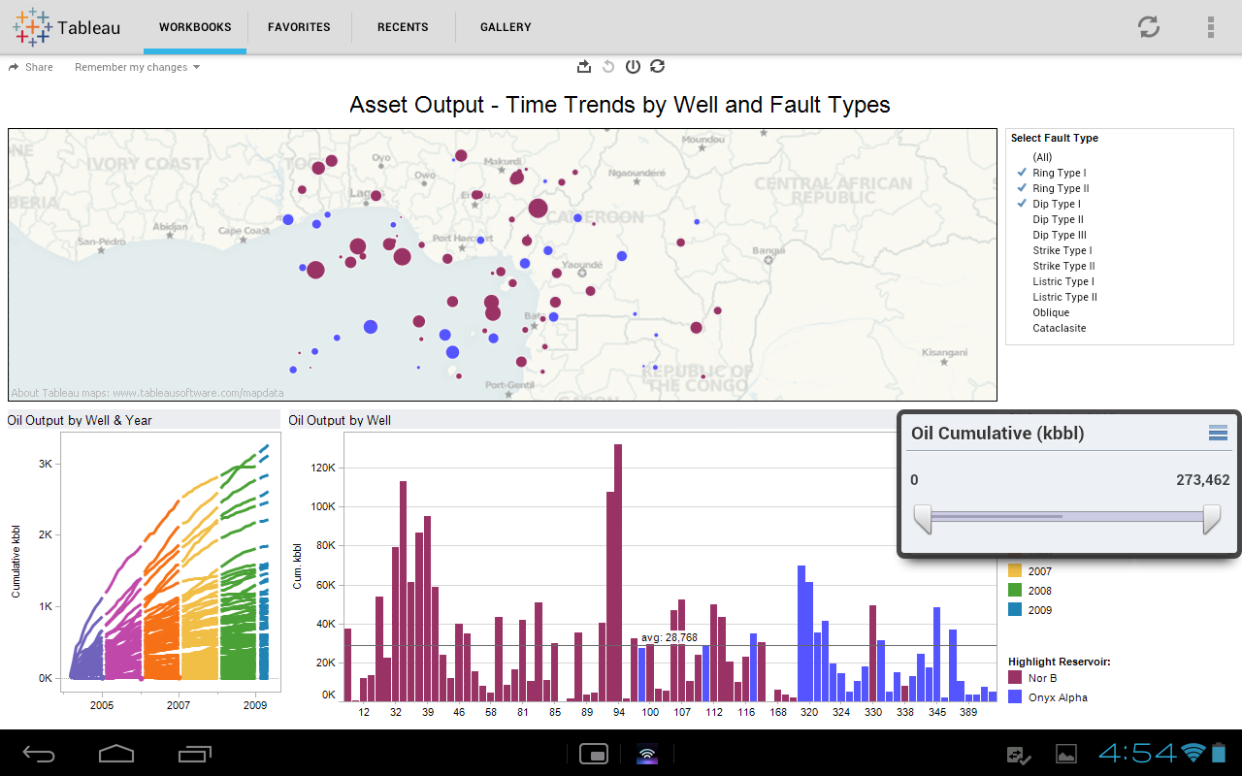
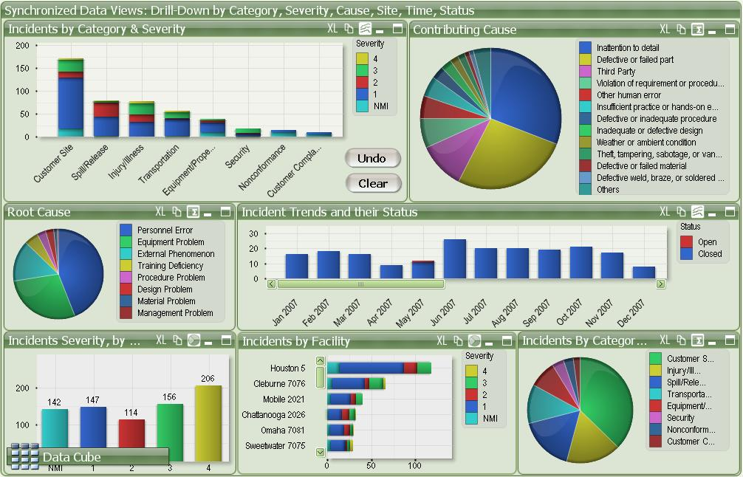
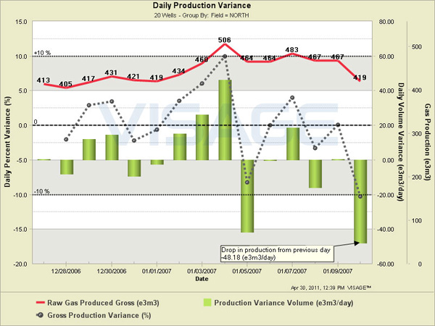
Only the Presentation Layer is visible to end-users
Sophisticated Visual Analytics is useless without superior data
Notes:
The application infrastructure layers I showed on the last slide are invisible to most end-users
Typically it’s only the Presentation Layer that is visible to most end-users
Very few end-users delve into software development and start to appreciate the depth of the infrastructure that’s required to support the output everyone sees, uses and often loves
Why do end-users love this visual analytics output?
It’s not just the pretty colors
This visual analytics output helps end-users improve their job effectiveness
At a minimum it saves them the drudgery of manually integrating data they need using Excel
How many of you use one of these Visual Analytics software packages?
More than one?
However, sophisticated Visual Analytics is useless without superior data
Without that data, Visual Analytics just produces colorful and pretty garbage
That’s where PPDM comes in as a critical component of the data management strategy

Slide 6
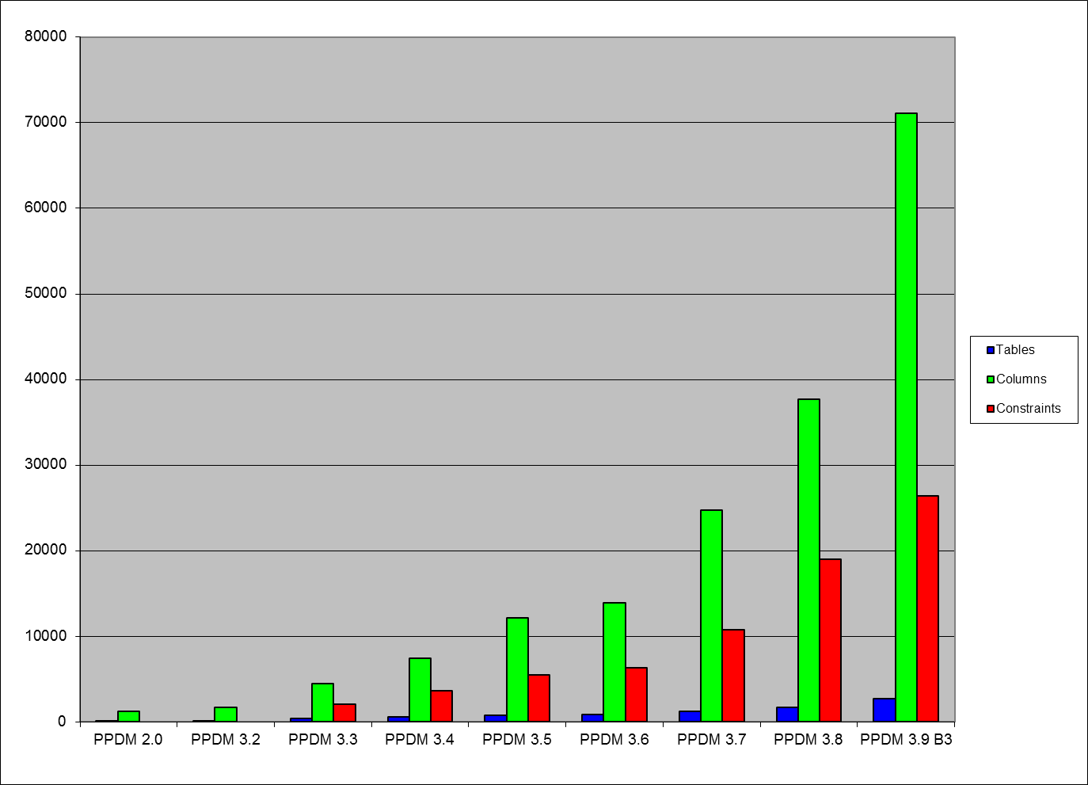
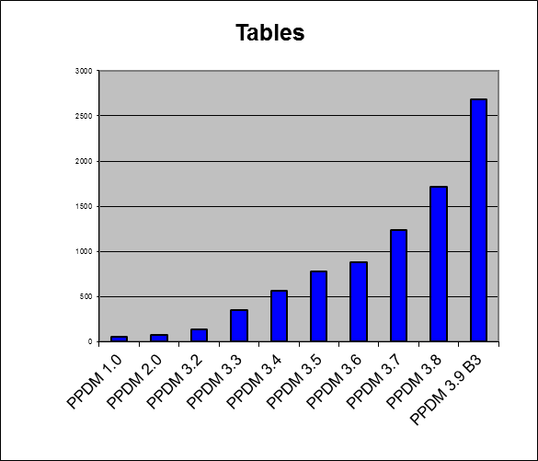
PPDM Growing Complexity, Growing Value
71,000
2,700
Notes:
PPDM - Growing coverage, Growing complexity, Growing value
Over the years and through the various releases, PPDM has grown significantly to 71,000 columns and 2,700 tables
In a typical PPDM datastore not all of these columns and tables will be populated
However, the growing coverage of the E&P business data also produces the growing complexity that is evident
At the same time, it’s the growing complexity that is required to produce significant business value
The advanced capabilities of visual analytics software tames this complexity and can make PPDM datastores more visible and recognized as valuable
Are you adding more PPDM tables and rows each year? I hope so

Slide 7
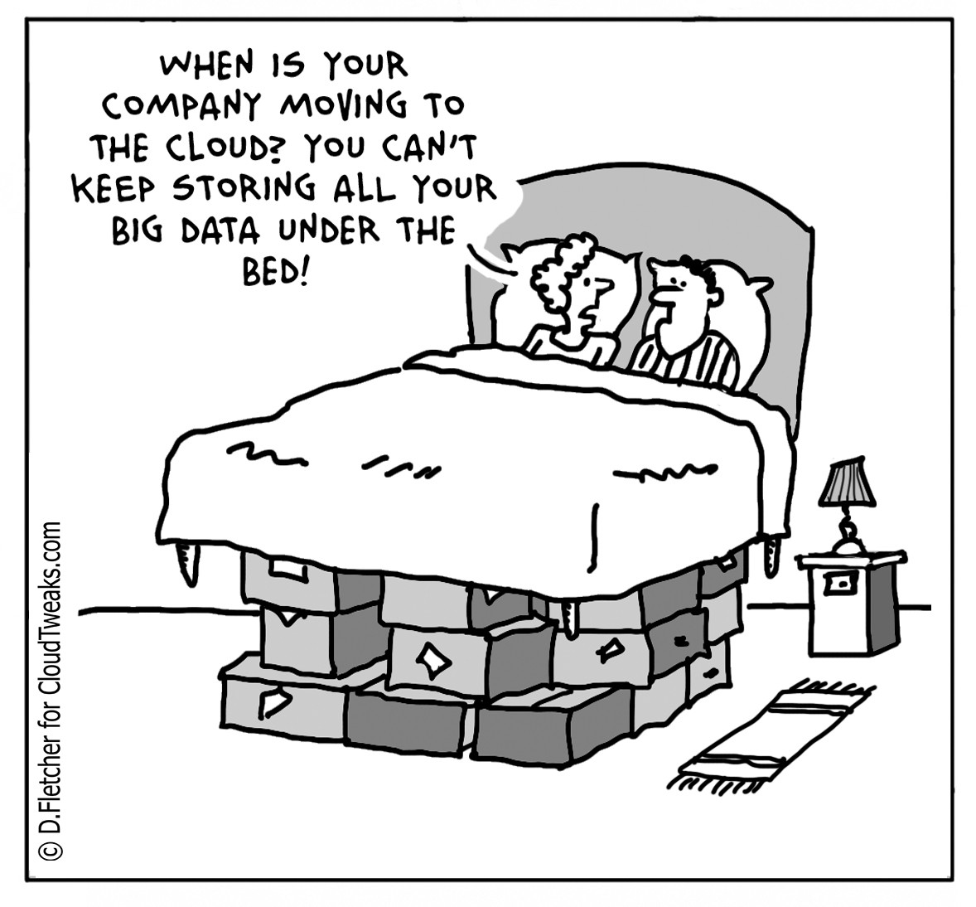
When is your oil company moving to PPDM?
You can’t keep storing all your big data under our bed!
Notes:
When is your oil company moving to PPDM? You can’t keep storing all your big data under our bed!
It’s never too late to make a bigger commitment to PPDM to bolster your data management strategy
PPDM paves the path to delivering business value from the investment your oil & gas company is making in data management
An ever growing pile of boxes or a growing number of disjointed datastores will take you in the direction of higher operating costs and disappointing business value

Slide 8
Oil & Gas Data Warehouse Context Diagram
Daily Production
data
Monthly Financial
data
Monthly Public well data
Monthly Proprietary well data
Monthly Public Frac data
Monthly CAPEX Forecast data
Data warehouse
8
Notes:
Let’s look at a conceptual view of the solution to the data management problems I’ve illustrated on the previous slides
Oil & Gas Data Warehouse Context Diagram
At oil & gas producers, visual analytics software typically accesses data from the listed datastores
In this example, I’m showing:
Field data capture that provides daily production data
Schlumberger Avocet or CGI PVR or Merrick eVIN or Quorum Gathering Management
ERP that provides monthly financial data
QByte FM or SAP or Oracle ERP or Excalibur
A public data vendor that provides monthly public well data
IHS Energy or geoLOGIC or DrillingInfo
Well data management software that provides monthly and transactional proprietary well data
Peloton WellView or Neuralog NeuraDB or Paradigm Epos or Petrosys dbMap
A public data vendor that provides monthly and transactional public fracturing data
Canadian Discovery WCFD or FracKnowledge
CAPEX management software that provides monthly CAPEX and OPEX forecast data
Energy Navigator ValueNavigator or Entero Mosaic
PPDM is used to varying degrees in all of these datastores
However, PPDM is mentioned rarely mentioned by the software vendors and therefore remains rather invisible to most end-users
Data warehouse:
Brings data together all of these datastores into a single authoritative view
Highlights data quality issues such as key mismatches or contradictory data for resolution
With or without the data warehouse, this is the data, much of it PPDM, that visual analytics makes useful and visible
Do you operate most of these datastores?
How easy or difficult are they to link or integrate?

Slide 9
Visual Analytics Application Context Diagram
VA app
Update
Data warehouse
VA app
Configuration data
VA app
Summary data
Visual Analytics application
Graphs
Tables
Reports
Exports
Notes:
Visual Analytics Application Context Diagram
In describing the context of the Visual Analytics Application, let’s continue the story from the data warehouse I described on the last slide
The Visual Analytics Application reads data from the data warehouse as you’d expect
The Visual Analytics application typically produces a wide range of output artifacts
The most valuable artifacts are the graphs that are available in huge variety
The other artifacts are very tabular; On these artifacts it’s difficult for us visually-oriented humans to spot trends or problems
Visual Analytics applications can either access the data warehouse or the underlying application datastores directly
For example, a highly useful Visual Analytics query goes something like this:
Select wells in Western Canada where my working interest exceeds 50%, that have been profitable during the past 3 years but where that profitability is declining, and where the reserve life index is greater than 3
For the selected wells, create a series of monthly graphs for the past 3 years showing revenue, operating expense, production volume in boe/day, net income
The goal is to identify wells that are under-performing, can benefit from more production engineering attention and are likely worth investing that attention
A similar query will identify dogs the will not benefit from attention and should be sold or abandoned
Can you describe a complex query that your end-users have found valuable?
The most valuable queries tend to require a data contribution from multiple datastores

Slide 10
Visual Analytics
graph
A picture is worth a thousand rows of data
Notes:
Visual Analytics
How does Visual Analytics actually make PPDM data visible?
We’ve all heard the phrase: A picture is worth a thousand words
In a visual analytics context, a graph is worth more than a thousand rows of data

Slide 11
Questionable Analysis Goals
Notes:
Questionable Analysis Goals
Let’s see how big data and visual analytics are used in Dilbert’s company
I need you to assemble a huge amount of totally incomprehensible data.
Make it boring so no one looks at it too closely.
I’m aiming for quantity over quality.
Dilbert: Wednesday December 05, 2012
This is of course an extreme situation
But more practically, are we making the data management and query environment so complicated, that our sponsors and end-users have given up on seeing a valuable result?
Focus on a little data and a few related queries first
Too often we try to improve the data management for most of the data first, before we turn our attention to the queries
This approach is doomed to failure because the organization loses interest before we reach the goal line

Slide 12
Visual Analytics Definition
Visual analytics combines automated analysis techniques with interactive visualizations to enable:
Effective understanding
Reproducible reasoning
Defensible decision-making
in the context of large and complex data sets
Notes:
Visual Analytics Definition
Visual analytics is more than just visualization
Visual analytics is an integral approach to decision-making that combines visualization, human factors and data analysis
Visual analytics combines automated analysis techniques with interactive visualizations to enable:
Effective understanding
Reproducible reasoning
Defensible decision-making
in the context of large and complex datasets
Typical PPDM-based datastores certainly qualify as large and complex datasets
I think of large as referring to the number of rows; often in the millions
Complex refers to the number of tables and number of foreign keys; often in the dozens or perhaps even in the low hundreds
Do you have an example where you’ve applied Visual Analytics and delivered significant business value?

Slide 13
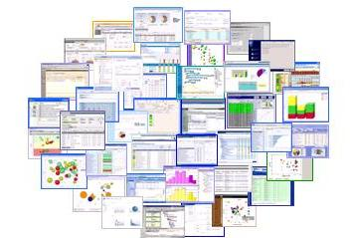
Visual Analytics Goal
Synthesize information and derive insight from massive, dynamic, ambiguous, and often conflicting data
Detect the expected and discover the unexpected
Provide timely, defensible, and understandable assessments
Communicate assessments effectively for action
Notes:
Visual Analytics Goal
The goal of visual analytics is the creation of tools and techniques to enable people to:
Synthesize information and derive insight from massive, dynamic, ambiguous, and often conflicting data
Detect the expected and discover the unexpected
Provide timely, defensible, and understandable assessments
Communicate assessments effectively for action
Another way to state the goal is that finding actionable patterns and relationships in torrents of numbers or endless rows in Excel spreadsheets is impossible; hence the need for visualization
Similarly, finding actionable patterns and relationships in databases accessed by a multitude of distinct applications is impossible
Have you experienced being unable to find a value in an Excel spreadsheet that you know is there?
Visual Analytics is not presenting the end-user with:
An avalanche of monotonous data
A huge number of disparate applications

Slide 14
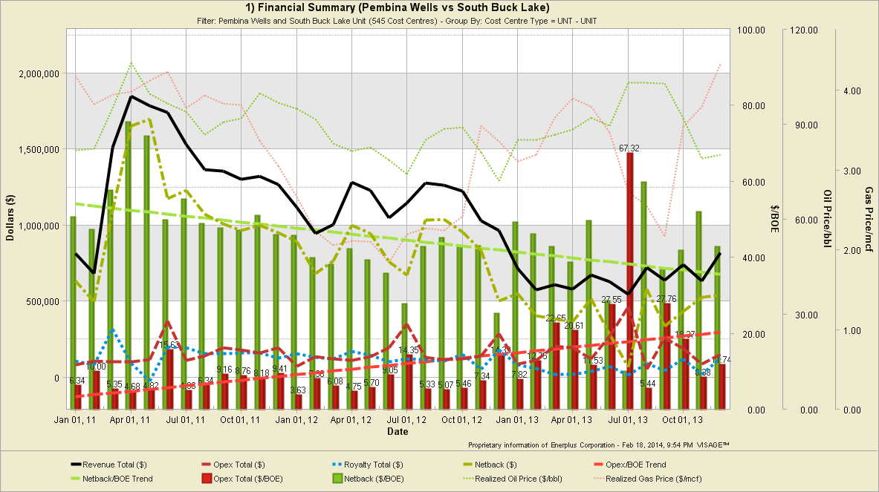
Producing Property Profitability Analysis
Notes:
Let’s look briefly at some Visual Analytics graphs
Producing Property - Profitability Analysis
This graph may look busy but it brings all the data you need to make informed decisions together in one place at one time
The data includes:
Gross revenue
Total expense
Net back or gross margin
Realized unit price in $/BOE
You don’t have to engage in mental contortions to see the whole picture
The key trend here is that profitability is trending down significantly because unit sales price is trending down slightly while operating costs are trending up
Many analytic situations wrestle with the interplay of multiple variables
This interplay becomes confusing very quickly
Visual presentations like this help us to understand the issue/opportunity
From this graph we can drill in look at individual wells
Often a few poorly performing wells are overshadowing the positive results from many reasonably performing wells
We want the engineers to focus their attention on the laggards
We can also drill in to look at volume, revenue or cost data
Sometimes a reasonable cost trend is being overshadowed by an adverse revenue trend as we’re experience currently in 2015
Sometimes a trend is an illusion because data problems are skewing the graph
Can you see how this graph can lead to quick, yet confident analysis?

Slide 15
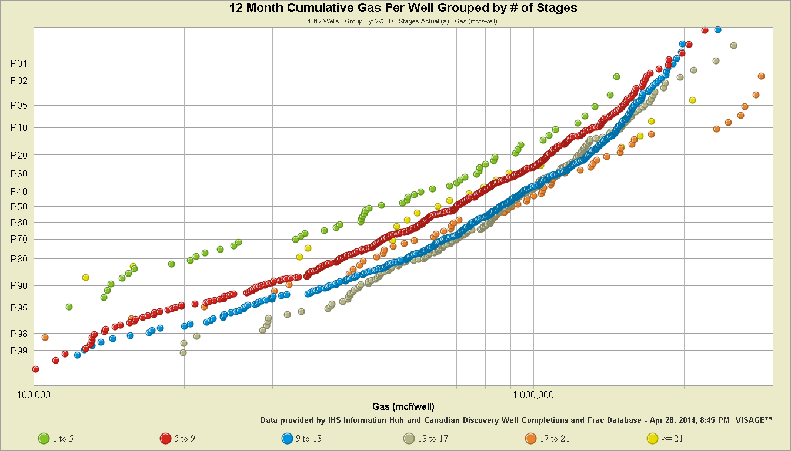
Optimizing Frac Design
More production
Notes:
Frac Analysis In VISAGE: How Adding More Stages Impacts Gas Production
http://www.visageinfo.com/2014/04/28/frac-analysis-in-visage-how-adding-more-stages-impacts-gas-production/
Jim G: There is clearly a trend towards higher well rates with more fracture stages. To truly determine the impact of increased fracture stages alone we would need to add some additional filters, such as; operator, type and amount of frac fluids, cluster spacing, horizontal well length and the staging plus the amount of proppant . The variability of all of these frac characteristics are inherent in the distributions shown. We know that the industry trend has generally been toward bigger fracs, with more proppant and more fluid. What we can see from this plot is that the combination of all of the above has been working.
What is interesting is that the distribution for the 9 to 13 stages is clearly better than the 5 to 9 stages. The trend for 13 to 17 is similar across much of the distribution. As expected we see additional mitigation of the downside as we introduce more stages. The results for 21 and more stages would be genuine cause for a pause and re-assessment. Again we would need to filter the data to assure that we have a consistent operator and technology being employed. However, if they were consistent, the data would suggest that we have over capitalized when we have in excess of 13 stages.

Slide 16
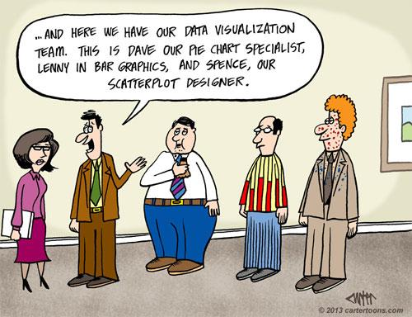
. . . And here we have our data visualization team.
Dave is our pie chart specialist, Lenny is into bar graphs, and Spence is our scatterplot designer.
Notes:
. . . And here we have our data visualization team. Dave is our pie chart specialist, Lenny is into bar graphs, and Spence is our scatterplot designer.
I’m not convinced a huge team or budget is required to deliver value from visual analytics

Slide 17
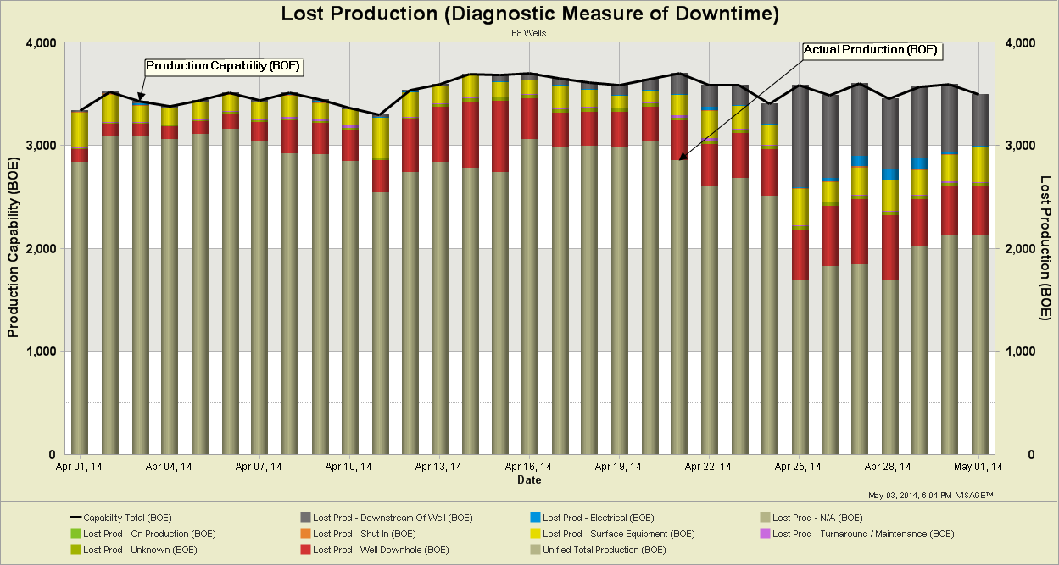
What is well downtime costing your company?
Lost
Production
Actual Production
Notes:
What is well downtime costing your company?
This more sophisticated view is much more useful that simple downtime chart of hours by day or hours as a percent of day or month
The black line across the top is well capability volume
The green histogram is actual production volume
The other colored histograms are various reasons for lost production
The bottom line is that this company’s production is falling due to downtime
These charts can show you the whole company picture
Then you can drill in by area, business unit, property and individual well to see where you need to focus your remedial work
This chart shows downtime in terms of lost volume impact
That works well for engineers
You can also display downtime as net revenue lost
That panics senior management and the financial accountants

Slide 18
Daily Production Variance
Notes:
Daily Production Variance
Here’s an oil & gas example of using visual analytics to better understand daily production variance
You’ll immediately see that the data is presented in a clear and understandable way
Values from the daily production database are displayed
The variance calculations are predefined so there’s high confidence there are no arithmetic issues
If you just looked at the top line, you’d think that daily gas production is doing reasonably OK
However, the histograms point to significant but undesirable day to day swings that merit more attention
What’s not obvious in this image is that all the graphic elements are clickable to drill into the data:
To narrow down on the source of the problem variance
To present the data on another chart for a different view
By changing the date range
By changing the line types or colors with a single click

Slide 19
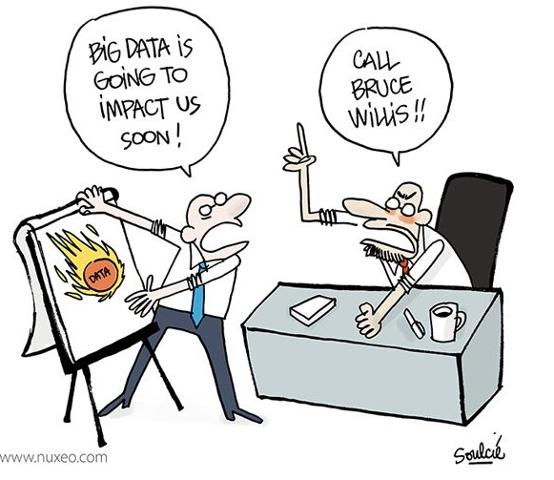
Big data will overwhelm
our organization like this flaming asteroid!
Don’t worry,
I’ll call Bruce Willis!
Notes:
Big data will overwhelm our organization just like this flaming asteroid can obliterate our planet!
Don’t worry, I’ll call Bruce Willis!
Even if you view big data as big crisis with the power to crush or incinerate your organization, I doubt that calling Bruce Willis of Armageddon fame will solve the problem
However, employing visual analytics with PPDM will deliver value from all the data you’re collecting

Slide 20
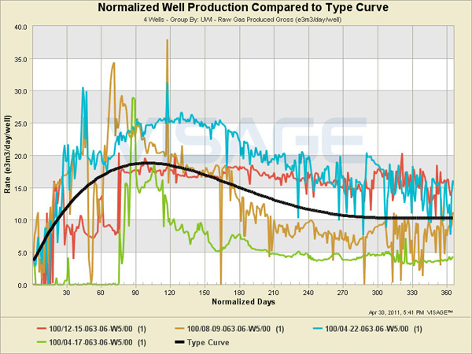
Well Type Curve Analysis
Notes:
Well Type Curve Analysis
In this analysis we are comparing the production rate of a selected set of wells to a type curve, the black line, that we’ve developed for the area
We use the type curve to see how the wells are performing relative to expectation and how they are performing compared to each other

Slide 21
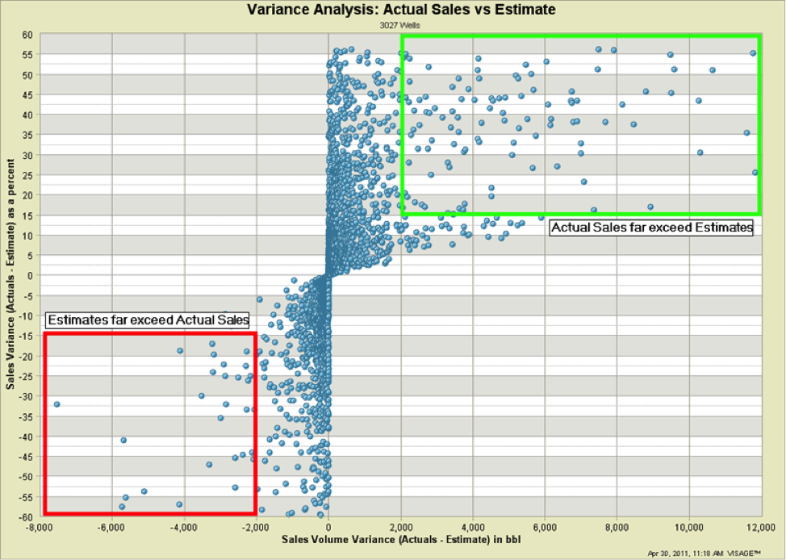
Comparison of Actuals Sales to Estimates
Estimates far exceed Actual Sales
Actual Sales far exceed Estimates
Notes:
Integrated Analysis: Comparison of Actuals Sales to Estimates
A picture is worth a thousand rows of data, allowing you to easily identify the areas of greatest concern
This visual shows a scatter plot of percent variance vs. volume variance between estimated sales volumes (from field data capture) and actual sales volumes (from accounting)
The two areas outlined are where the variance percent exceeds 15% and the volumes are significant
Now your business analysts can focus their attention on a targeted group of wells
This analysis will improve your forecasts, improve your accruals and identify cash receipts coding errors
With good visual analytics software, the effort to create this chart is measured in minutes; with Excel and data access or integration issues you are looking at hours or days
I’ve shown you a few example charts that illustrate:
The variety of analysis that is possible
The variety of charts that can be produced
The variety of business situations where visual analytics can be deployed
Have I sparked any ideas you want to explore further when you return to your office?
Do you want to share a few ideas?

Slide 22
Recommendations
Improve your data management processes
Identify operational problem
Select visual analytics software package
Pilot software package for problem
Build on pilot success
Notes:
Recommendations
Here are some recommendations to consider
Improve your data management processes with PPDM
Visual analytics illuminates data quality problems that undoubtedly exist across your various datastores that underlie your application portfolio
Expect to allocate some resources to data quality
Identify an operational problem
You can likely identify a few operational problems that could be addressed by bringing better data to the workstations of key staff involved
Pick one problem that’s modest in scope and where the business is demonstrating some interest, energy and leadership
Select a visual analytics software package
Select a visual analytics software package to pilot
Select an application in preference to a tool if a credible application exists for your industry
Pilot the visual analytics software package to address the operational problem
Ensure functional management interest/sponsorship
Train a small team
Build the visual artefacts that will help the staff address the problem
Build on pilot success
Assuming the pilot is a success, plan to rollout the visual analytics product across more departments
Plan to widen the coverage of PPDM data
Address data quality issues uncovered by your pilot

Slide 23
Questions & Discussion
Can you help us
implement visual analytics for PPDM?
Please
fill out
evaluation
form
Notes:
Questions & Discussion

Slide 24
How Visual Analytics adds value to PPDM Datastores
Yogi Schulz
Partner of Corvelle Consulting
Information technology related management consulting
Microsoft Canada columnist & CBC Radio host
Industry presenter
Former PPDM Association board member
Corvelle Consulting
300, 400 - 5 Ave. S. W.
Calgary, Alberta T2P 0L6
Phone: (403) 249-5255
E-mail: YogiSchulz@corvelle.com
Web: www.corvelle.com
Notes:
How Visual Analytics adds value to PPDM Datastores

Slide 25
Bibliography
Do you need big data for big results?
http://www.corvelle.com/do-you-need-big-data-for-big-results/
Business Intelligence – experiencing more hype than value?
http://www.corvelle.com/business-intelligence-experiencing-more-hype-than-value/
Is data modelling really dead?
http://www.corvelle.com/is-data-modelling-really-dead/
Why you need visual analytics
http://www.corvelle.com/resources/articles/it-world-canada/why-you-need-visual-analytics/

Slide 26
Value of Visual Analytics
Make data-driven decisions “very frequently”
Make decisions “much faster” than market peers
Execute decisions as intended “most of the time”
Notes:
Value of Visual Analytics
This list describes the value that Visual Analytics provides to help companies differentiate themselves as leading companies relative to their peers and competitors
http://www.bain.com/Images/BAIN%20_BRIEF_The_value_of_Big_Data.pdf
Make data-driven decisions “very frequently” as opposed to infrequently or decisions made based largely on experience or gut feel with limited or incomplete information
The production engineers I work with currently have been frustrated by how often they’ve made investment decisions based on incomplete information; they recognize the risk
For example, I wonder how many oil & gas acquisition decisions are based on gut feel with limited or incomplete information
Make decisions “much faster” than market peers as opposed to more slowly or even ponderously
This concept is often called speed to insight
It’s important because in many competitive situations, the first or fast mover ends up with most of the market share
For example, I was impressed how quickly CNRL made the multi-billion dollar offer to Devon to buy the Canadian conventional assets
Execute decisions as intended “most of the time” as opposed to having decisions be derailed, become sidetracked or stall out during execution
For example, I notice that merger projects are often deemed complete even when the work is far from complete because the budget has run out or because of organization fatigue
To our client this value amounts to millions of dollars in incremental net revenue per year without adding:
More dollars to the capital budget
More staff to the operating budget
I hope some opportunities to employ visual analytics in your business are popping up in your mind
Any ideas you might want to share?

Slide 27
Digital Oil Field Survey
Upstream companies struggle with adequately managing information for analytical purposes
Data is typically stored within applications in nonstandard formats
Data is trapped within organizational silos
Real-time data from field sensors is managed independently by various organizational entities
Making progress in analytics requires action across multiple organizational silos
Notes:
Gartner Digital Oil Field Survey
Top 10 Business Trends Impacting the Upstream Oil and Gas Industry in 2015
Published: 29 March 2015
File: top_10_business_trends_impac_274047.pdf
Upstream companies struggle with an even deeper problem — adequately managing information for analytical purposes
Data is typically stored within applications in nonstandard formats
Data is trapped within organizational silos
Real-time operating data from field sensors is typically managed independently by many different organizational entities, making it difficult to integrate with data from other sources such as transactional, financial, asset and public data
Making progress in advanced analytics requires coordinated action across multiple organizational silos to improve information management and, once again, IT is well-positioned to lead improvement efforts
How should oil & gas producers address these issues?
With visual analytics and PPDM

Slide 28
Opportunities from Superior Information Management
Improving utilization of existing data sets
Reinterpreting to identify closely missed targets
Identifying potential candidates from existing datasets
Reusing seismic pre-stack data archives
Reusing well datasets for:
well log re-processing
petrophysical analysis
Notes:
Current slump in Oil industry and Importance of Information Management
Arshad Malik, July16th 2015
http://blog.lmkr.com/current-slump-in-oil-industry-and-importance-of-information-management/
Improving utilization of existing appropriately managed data sets to avoid new seismic and other data acquisitions saving millions of dollars
Reinterpreting to identify closely missed targets by restoring the old archived interpretation projects/sets
Identifying potential candidates through the existing data sets. If the existing archives are managed properly, data can be used to identify the potential candidates for seismic reprocessing activity in order to provide new datasets for critical interpretation projects
Reusing usage of well managed seismic pre-stack data archives for reservoir characterization, AVO analysis for detailed field/ basin level studies/ interpretations
Reusing well data sets, if properly managed, for well log re-processing and petrophysical analysis for detailed field level studies/interpretations

Slide 29
Visual analytics is about:
Displaying PPDM data as pretty pictures
Using overly complex terms as a way of charging more for software licenses
Representing data for analysis and insights in ways that resonate
Over analyzing data to avoid reaching any actionable conclusions
Notes:
Visual analytics is about:

Slide 30
PPDM is valuable because:
It brings us together in a great mountain setting
It offers terrific careers in information technology
It improves productivity through improved data accessibility, accuracy and reliability
It keeps software developers employed
Improves communication among prickly explorationists and IT professionals
Notes:
PPDM is valuable because:

Slide 31
What is the difference between visual analytics and business intelligence?
Very little; marketers prefer visual analytics because it sounds more sophisticated
Less and less; visual analytics and business intelligence are merging into a unified platform
A lot; visual analytics produces interesting, insightful, colorful graphs while business intelligence produces boring rows and columns
Vast differences; visual analytics is for visual right-brain thinkers while business intelligence is for kinesthetic left-brain thinkers
Notes:
What is the difference between visual analytics and business intelligence?
Very little; marketers prefer visual analytics because it sounds more sophisticated allowing them to charge more
Less and less; visual analytics and business intelligence are merging into a unified software platform for information delivery, analysis and integration
A lot; visual analytics produces interesting, insightful, colorful graphs while business intelligence produces boring rows and columns of data
Vast differences; visual analytics is for visual right-brain thinkers while business intelligence is for kinesthetic left-brain thinkers

Slide 32
How do production engineers really produce more oil & gas?
Eavesdrop on their peers at Starbucks for ideas
Rely on field operations to do a better job
Diligently monitor wells and pursue optimization opportunities
Harass their IS staff for better systems and PPDM data
Notes:
How do production engineers really produce more oil & gas?

Slide 33
What is the difference between a data mart and a data warehouse?
A PPDM data warehouse typically contains multiple PPDM data marts
A PPDM data mart typically contains multiple PPDM data warehouses
One of the few topics that Bill Inmon and Ralph Kimball agree on
I don’t know; ask your local DBA
Notes:
What is the difference between a data mart and a data warehouse?

Slide 34
How are data marts linked in a data warehouse?
Very carefully
With binder twine
Not at all
Using foreign key relationships
Programmatically
Notes:
How are data marts linked in a data warehouse?

Slide 35
Visual Analytics Software Packages Selection Criteria
Visual exploration
Augmentation of human perception
Visual expressiveness
Automatic visualization
Visual perspective shifting
Visual perspective linking
Collaborative visualization
Notes:
Visual Analytics Software Packages - Selection Criteria
These are very unusual software selection criteria but I think they are important to software in the visual analytics category
The leading software tools and applications I’ve referenced can all handle the more common software selection criteria such as:
Can the software access the various databases and data formats I have in my organization?
Can the software produce the visualizations and dashboards I need?
Can the software perform the calculations I need?
Can the software produce the reports I need?
Can my development staff learn the tool reasonably easily?
The Gartner Magic Quadrant for Business Intelligence and Analytics Platforms includes an excellent set of selection criteria
Visual exploration – Querying, exploring and visualizing data occurs in a single process
Augmentation of human perception – Visual thinking is encouraged and developed – the brain’s ability to process pictures far faster than text is leveraged
Visual expressiveness – Visual displays have depth, flexibility and multi-dimensional expressiveness
Automatic visualization – Effective visualizations are automatically recommended
Visual perspective shifting – Shifting among alternative visualizations of any given data is effortless
Visual perspective linking – Multiple images are intimately linked so that a selection on one image highlights related, relevant data on the other images
Collaborative visualization – People can easily share and collaborate on useful information visualizations

Slide 36
Value of Visual Analytics
Eliminate guesswork
Answer business questions better & faster
Produce key business metrics consistently
Build insight into customers & problems
Learn how to streamline operations
Improve efficiency
Learn what your true costs are
See where your business has been, where it is now and where it is going
Notes:
Value of Visual Analytics
Ten Benefits of Visual Analytics
http://www.enterpriseappstoday.com/business-intelligence/ten-benefits-of-business-intelligence-software-1.html
Eliminate guesswork
Far too often, executives rely on 'best guess' and 'gut feel' decisions as they attempt to steer their companies into the future
Visual Analytics can provide more accurate historical data, real-time updates, synthesis between departmental data stores, forecasting and trending, and even predictive 'what if?' analysis
This capability eliminates the need to guesstimate; reduces the risk of a wrong recommendation based on too little analysis under time pressure
Answer business questions better & faster
Visual Analytics users can quickly produce better answers to business questions
Visual Analytics providers higher confidence that most of the alternatives have been thoroughly explored
Visual Analytics reduces development cost and elapsed time
This approach avoids spending hours reading through volumes of printed reports
Produce key business metrics consistently
Visual Analytics software makes it possible for users to access key business metrics consistently, reliably and repeatably period after period.
Build insight into customer behavior
One of the great benefits of Visual Analytics software is it allows companies to gain visibility into what customers are buying (or not). This insight gives companies the ability to turn this knowledge into additional profit and retain valuable customers.
Identify cross-selling and up-selling opportunities
Visual Analytics software allows companies to leverage customer data to build, refine and modify predictive models that help sales representatives to up-sell and cross-sell products at appropriate customer touch points.
Learn how to streamline operations
With detailed insights into business performance, companies can easily see where they need to make changes to streamline operations.
Improve efficiency
With Visual Analytics software, all the information is centralized and can be viewed in a dashboard or turned into a report, saving enormous amounts of time and eliminating inefficiencies.
Learn what your true costs are
Visual Analytics software can give end-users greater insight into costs and the ability to adjust production on the fly for greater profitability.
Manage inventory better
Visual Analytics software can help you order the right amount of inventory at the right time so that customers receive their products when they need them. Your business doesn't bear the cost of stocking excess inventory.
See where your business has been, where it is now and where it is going
Visual Analytics is very successful at explaining what happened in the business and develop a realistic forecast for the future.

Slide 37
Value of Standards
Data can be exchanged in a seamless manner between systems, between companies and with regulators
Geoscientists and engineers no longer waste time resolving data quality lapses
When incidents occur, you have immediate access to trusted data
Notes:
The key benefits for the industry in adopting standards are:
Data can be exchanged in a seamless, reliable, predictable manner between systems, between companies and with regulators
Better data quality leads to better business productivity
Geoscientists and production engineers no longer have to waste time resolving data quality lapses related to data import, integration and validation, which historically has led to massive inefficiencies
When incidents occur, you have immediate access to trusted data
Standards can help deliver safer operations by ensuring that information is available for a rapid response to any incident

Slide 38
Notes:
Big Data in Oil and Gas: How to Tap Its Full Potential
Hitachi Data Systems, August 09, 2013
http://www.slideshare.net/hdscorp/big-data-in-oil-and-gas-how-to-tap-its-full-potential

Slide 39
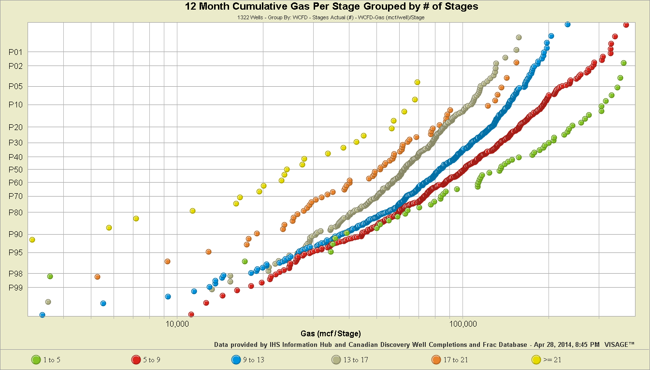
Duplicate
Notes:
Jim G: All other factors being equal, our expectation should be that as we increase the number of fracture stages we will initially see linear gains and then we should see diminishing returns. At what point this will occur will be driven by the Geology as well as the frac design. In the scenario where we are developing simpler bi-wing fractures with minimal width, the number of fracture stages required will be a function of the reservoir’s matrix permeability. The tighter the rock matrix the closer we will need to put the stages to efficiently drain a given volume over say a 20 year period. The length of time to consider in your design should be a reflection of your company’s discount rate and expected rate of return, and as such, should be relatively unique to your firm.
When we have a stress regime and rock mineralogy which is conducive to complex fractures, then the width of our Stimulated Rock Volume (SRV) will be driven by the type of fluid, and how much fluid is pumped per stage. Technology will also play a part, as Zipper fracs, Pulse and Highway fracs will be more efficient at generating new SRV. Assuming all the wells used the same fracturing technology, with the same cluster spacing (do they ever?) and that we are generating complex, or so called brittle failure fractures, then we will see similar patterns to the bi-wings. The major difference being that much fewer fracture stages will be required, especially if Zipper fracs are used.
What we are observing in the plot of 12 month cumulative gas production per stage is interference between stages early as the number of stages increases. Note that the plot for 1 to 5 stages is much higher on average than 5 to 9 and the others. What we are seeing is that the impact is observed in the best wells and not noticeably in the poorer wells. This makes sense as rate has been shown to be proportional to SRV.
The best wells will have the greatest SRV. As we add more stages the good wells, with larger SRV, will be impacted sooner. We will see overlapping stage SRV’s, where stages interfere with one another and compete for drawdown.
In the poorer wells we have limited SRV’s and as such there is a lot more area between the stages to optimize in terms of developing a stimulated rock volume. Notice the limited deviation in the curves (on the poorer performing well portions of the distributions) between 1 to 5 stages and 5 to 9 stages and to a lesser extent on the 9 to 13 stages.

Slide 40
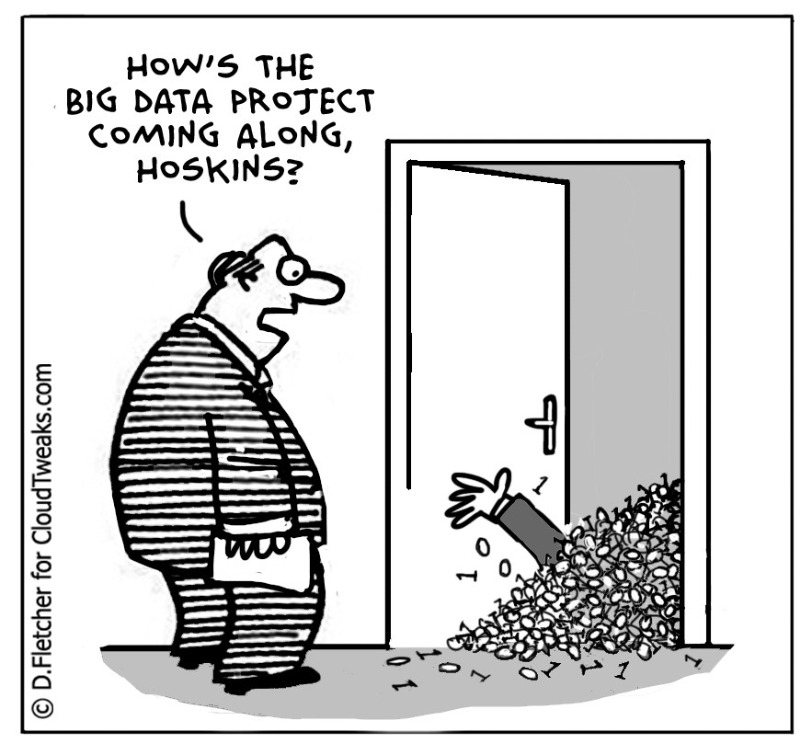
How’s the big data project coming along,
Hoskins?

Slide 41
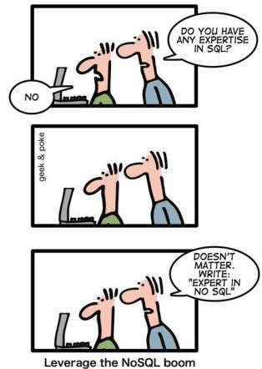
How to Write a Resume
Do you have any expertise in SQL?
Doesn’t matter Write: “Expert in NoSQL”.

Slide 42
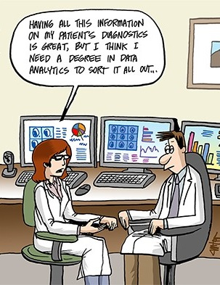
Having all this PPDM-managed data available for our wells is great, but I think I need a degree in data analytics to sort it all out.

Slide 43
Bulking Up the Data Management Staff
Let me introduce you to James, our data steward, Bill, our data custodian and “Moose”, our data bodyguard.
Notes:
A2 Cartoon: Bulking Up the Data Staff
Jon Carter, 6/16/2014
http://www.allanalytics.com/document.asp?doc_id=273689

Slide 44
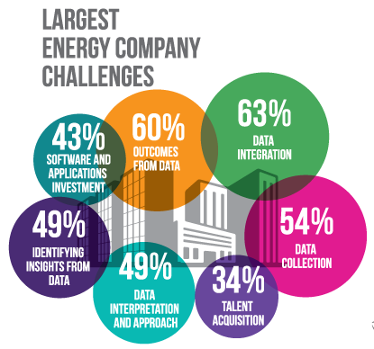
Notes:
The Financial Post article mis-attributed the study to us, as the statistics quoted come from an info graphic we produced here:
http://www.cdmn.ca/canadian-digital-media-trends-by-the-numbers-september-2014/
The actual statistics come from an Accenture study here:
http://www.accenture.com/SiteCollectionDocuments/PDF/Accenture-Digitizing-Energy-Analytics-Powered-Performance.pdf)

Slide 45
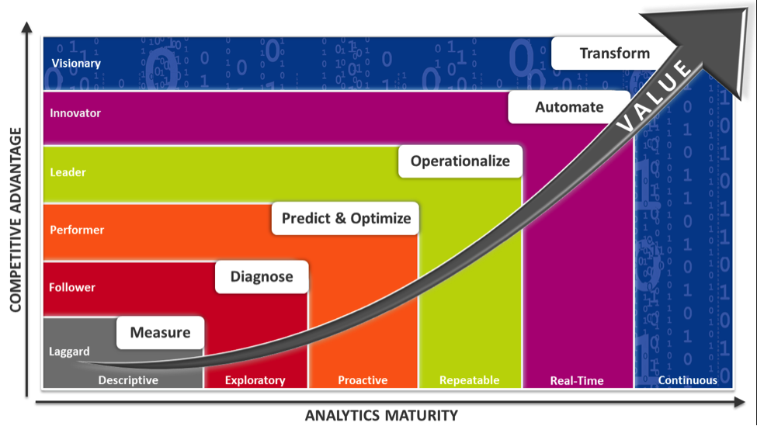
Making Big Data Actionable
Notes:
Making Big Data Actionable
http://blog.bardess.com/2014/02/10/making-big-data-actionable/
Source: TIBCO Spotfire
I think this TIBCO Spotfire maturity model for analytics is excellent
You can use it to think about where you’re various applications fit
You can use it to identify opportunities to strengthen your analytics functionality

Slide 46
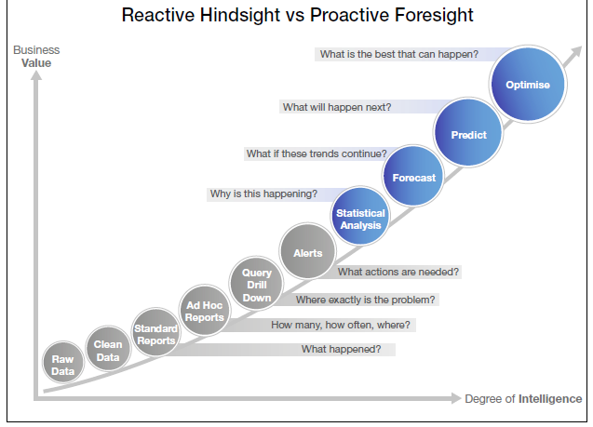
Business Value of Analytics Reactive Hindsight vs. Proactive Foresight
Notes:
Business Value of Analytics - Reactive Hindsight vs. Proactive Foresight
3 reasons why only a few countries can use analytics for public sector
Orkun Basaran
http://youngsday.com/2014/03/26/why-only-a-few-countries-managed-to-establish-analytical-solutions-for-public-sector/#sthash.QEXlwciM.dpuf
Another way to think about your analytics is to categorize every application you have into one of two piles
Which ones produce useful Reactive Hindsight or describe the events of the recent past?
Which ones produce useful Proactive Foresight or point to emerging problems or opportunities?
Naturally you want to give priority to enhancing data and functionality that will deliver more Proactive Foresight

Slide 47
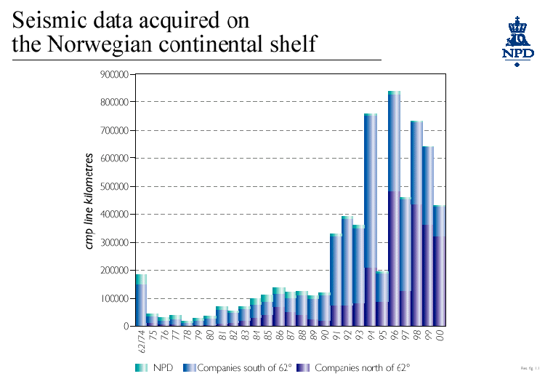
Data Volumes Growing each Year
Notes:
Data Volumes are Growing each Year
This is an example of Seismic Data Acquired by year in the Norwegian Continental Shelf
http://www.npd.no/engelsk/npetrres/petres2001/kap2_no.htm
If we had more time, I could show you similar spectacular growth charts for digital well logs, well data, facilities data, production data
Perhaps this cartoon of a data flood is a better way to describe the trend that most oil & gas producers are choking on
PPDM is an important technology that helps makes sense of all the data

Slide 48
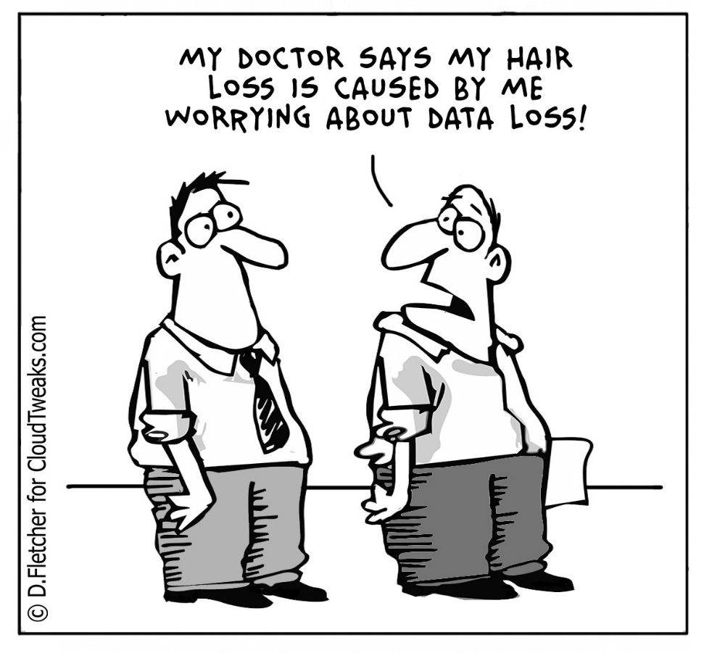
My doctor says my hair loss is caused by me worrying about data loss!

Slide 49
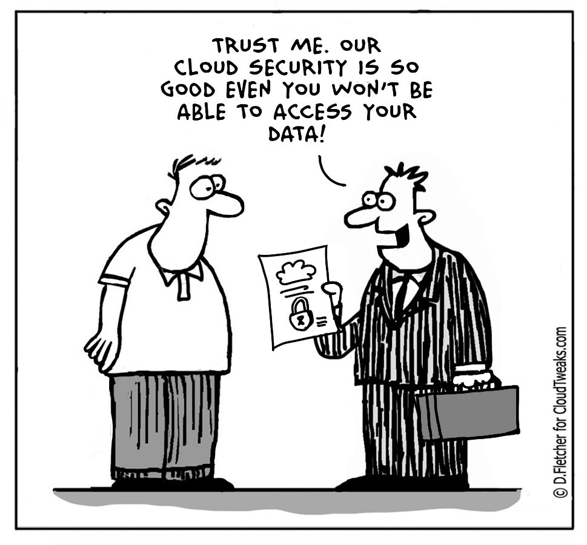
Trust me. Our cloud security is so good, even you won’t be able to access your data!

Slide 50
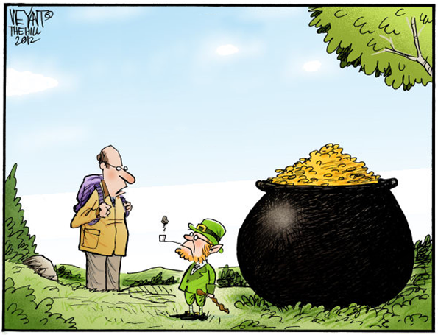
Any chance I could get better, faster, cheaper visual analytics instead?

Slide 51
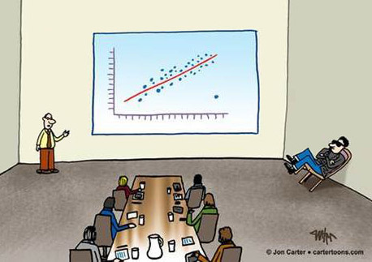
We have a nice-looking trend line here.
I want thank the entire team for contributing this data, including Gerald, for the outlier.
Notes:
A2 Cartoon: A Nod to the Outlier, 7/28/2014
http://www.allanalytics.com/document.asp?doc_id=274209

Slide 52
Factors in Seismic Data Growth
New algorithms
Multi-component datasets
Fold increases from 40 to 400
Bin grids decreased 110’ to 82.5’ on a side
Process at 2ms rather than 4ms
Notes:
Factors that are causing an exponential growth in seismic data
New algorithms are coming into play that is breathing new life into old data and interpolation of the data is creating huge data volumes, many more products, may pre stack products, it just goes on and on
Multi-component datasets will contain a least 3 times the data
Multi-component data sets are those recorded using more than one source and/or receiver type. The most common types are 3-component (converted wave) and 9-component surveys. Processing multi-component data sets is generally similar to standard P wave processing with the additional complication of component orientation and anisotropy. Other than these complicating factors, the major steps are roughly the same for both types of data.
http://www.geocenter.com/services/key_services/multi-component
Fold (traces/cdp) has increased from 40 to 400 in last 8 years
CDP - Common Depth Points
Fold = (Receiver Spacing x Number of Receivers) / (2 x shot spacing)
http://seismicreflections.globeclaritas.com/2013/06/marine-processing-part-2-initial-qc.html
http://www.xsgeo.com/course/acq.htm
Bin grids are more likely to be 82.5’ x 82.5’ onshore rather than 110’ x 110’
Process at 2ms rather than 4ms
These trends together have resulted in about a 35 times data density increase over the past decade

Slide 53
PPDM Value Proposition
Controls information technology costs
Improves productivity through improved data accessibility, accuracy and reliability
Increases fraction of available software that can be utilized
Improves consistency of communication among explorationists and IT professionals
Profitable, productive wells
Notes:
PPDM Value Proposition
I’ve been a member of the board of directors of the PPDM Association for almost 20 years now
During that time the model has grown in coverage and quality
The model has become an increasingly useful standard for data management in the oil & gas industry
As a one-liner, PPDM contributes to reducing E&P costs and increasing E&P staff productivity
Controls information technology costs
eliminates the need to develop, evolve and maintain internal data models and custom software
lowers systems costs to update and maintain duplicate information
Reduces cost to integrate data among disparate datastores
minimizes data transfer between software applications or multiple databases
Improves productivity through improved data accessibility, accuracy and reliability
improves the quality, quantity and timeliness of information
enhances business processes through clarification of data ownership
Increases fraction of available software that can be utilized
reduces take-up time for new software applications
Improves consistency of communication among explorationists and IT professionals
reduces risk through improved reliability with clear, concise data definitions
However, the bottom line is that everything in the oil & gas industry must contribute to profitable, productive wells
Implementing and using PPDM has made and continues to make a contribution to oil & gas producer profitability

Slide 54
About PPDM
Driving better business decisions through E&P data management standards
Through the PPDM Association, petroleum data experts gather together worldwide in a collaborative, round table approach to engineer:
business driven
pragmatic data management standards
that meet industry needs
Notes:
About PPDM
http://www.ppdm.org/about-ppdm

